Slide 1
Relational Database Implementation and Applications
Date of Presentation: 9/01/2023

Slide 2
Lesson 6: Concurrency Control
Gerald Balekaki

Slide 3
Concurrency Control
Motivation
Schedules must be conflict serializable, and recoverable,
for the sake of database consistency, and preferably cascadeless.
A policy in which only one transaction can execute at a time generates serial schedules,
but provides a poor degree of concurrency.
Concurrency-control schemes tradeoff between
the amount of concurrency they allow and the amount of overhead that they incur.
Concurrency control protocols generally do not examine the precedence graph for serializability
Instead, they impose a discipline that avoids non-seralizable schedules.
Goal – to develop concurrency control protocols that will assure serializability.

Slide 4
Intuition of Lock-based Protocols
Transactions must acquire locks on data items before accessing them
If a lock is held by one transaction on a data item,
this restricts the ability of other transactions to acquire locks for that data item
By locking a data item, we want to ensure that no access to that data item is possible that would lead to non-serializable schedules
The philosophy to design a lock model that guarantees that Lock-based concurrency protocols lies in a form of pessimistic concurrency control mechanism
We avoid ever getting into a state that can lead to a non-serializable schedule
On the other hand, Optimistic concurrency control mechanism do not avoid conflicts, but determine them later at commit time –
assuming committing a transaction would cause a non-serializable schedule to be generated.

Slide 5
Lock-Based Protocols
A lock is a mechanism to control concurrent access to a data item/element
Data items can be locked in two modes:
1. Exclusive (X) mode.
Data item can be both read as well as written.
X-lock is requested using lock-X instruction.
2. Shared (S) mode.
Data item can be read ONLY
S-lock is requested using lock-S instruction.
Lock requests are sent to concurrency-control manager.
Transactions do not access data items BEFORE having acquired a lock on that data item
Transactions release their locks on a data item only AFTER they have accessed a data item

Slide 6
Lock-Based Protocols …cont’d
Lock-compatibility matrix
A transaction may be granted a lock on an item,
if the requested lock is compatible with locks already held on the item by other transactions
Any number of transactions can hold shared locks on an item,
but if any transaction holds an exclusive lock on the item no other transaction may hold any lock on the item.
If a lock cannot be granted,
the requesting transaction is made to wait till all incompatible locks held by other transactions have been released.
Then, it is granted.

Slide 7
Lock-Based Protocols (Cont.)
Example of a transaction performing locking:
T2: lock-S (A);
Read (A);
unlock (A);
lock-S (B);
Read (B);
unlock(B);
Display (A+B)
Above locking is not sufficient to guarantee serializability — if A and B get updated in-between the Read (A) and Read (B) operations, the displayed sum would be incorrect.
A locking protocol is a set of rules a transaction must follow while requesting and releasing locks.
Locking protocols restrict the set of possible schedules.

Slide 8
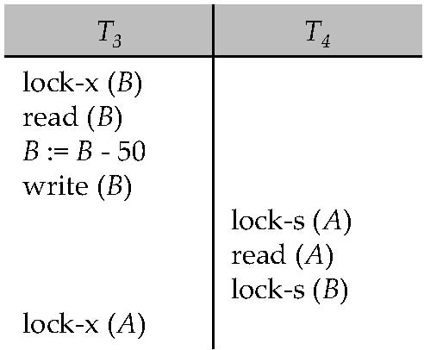
Drawbacks of Lock-Based Protocols
Consider the partial schedule Neither T₃ nor T₄ can make progress —
executing lock-S (B) causes T₄ to wait for T₃ to release its lock on B
whereas executing lock-X (A) causes T₃ to wait for T₄ to release its lock on A.
Such a situation is called a DEADLOCK.
To handle a deadlock one of T₃ or T₄ must be rolled back and its locks released.

Slide 9
Drawbacks of Lock-Based Protocols (Cont.)
There is potential for deadlocks to exist in most locking protocols.
Deadlocks are a necessary evil.
Starvation is also possible if the concurrency control manager is badly designed.
A transaction may be waiting for an X- lock (exclusive) on an item, while a sequence of other transaction requests are granted an S-lock (Shared) on the same item.
The same transaction is repeatedly rolled back due to deadlocks.
Concurrency control managers can be designed to prevent starvation.

Slide 10
The Two-Phase Locking (2PL) Protocol
2PL protocol ensures conflict-serializable schedules.
Phase 1: Growing Phase
transaction may obtain locks
transaction may not release locks
Phase 2: Shrinking Phase
transaction may release locks
transaction may not obtain locks
The protocol assures serializability.
It can be proved that the transactions can be serialized in the order of their lock points -- where a transaction acquired its final lock.

Slide 11
The Two-Phase Locking (2PL) Protocol (Cont.)
Two-phase locking does not ensure freedom from deadlocks
Cascading roll-back is possible under two-phase locking.
To avoid this, follow a modified protocol called strict two-phase locking (S2PL).
Here a transaction must hold all its exclusive locks till it commits/aborts.
Rigorous two-phase locking (SS2PL) is even stricter:
Here, all locks are held till commit/abort time.
In this protocol transactions can be serialized in the order in which they commit.

Slide 12
Lock Conversions
Two-phase locking with lock conversions:
– First Phase:
can acquire a lock-S on item
can acquire a lock-X on item
can convert a lock-S to a lock-X (upgrade)
– Second Phase:
can release a lock-S
can release a lock-X
can convert a lock-X to a lock-S (downgrade)
2PL protocol assures serializability.
But still relies on the programmer to insert the various locking instructions.

Slide 13
Automatic Acquisition of Locks
Suppose a transaction T_{i} issues the standard read/write instruction without explicit locking calls.
The operation read(D) is processed as:
if T_{i} has a lock on D
then
read(D)
else begin
if necessary wait until no other
transaction has a lock-X on D
grant T_{i} a lock-S on D;
read(D)
end

Slide 14
Automatic Acquisition of Locks (Cont.)
The operation Write (D) is processed as:
if T_{i} has a lock-X on D
then
write(D)
else begin
if necessary wait until no other trans. has any lock on D,
if T_{i} has a lock-S on D
then
upgrade lock on D to lock-X
else
grant T_{i} a lock-X on D
write(D)
end;
All locks are released after commit or abort

Slide 15
Implementation of Locking
A lock manager can be implemented as a separate process to which transactions send lock and unlock requests
The lock manager replies to a lock request by sending a lock grant messages (or a message asking the transaction to roll back, in case of a deadlock)
The requesting transaction waits until its request is answered
The lock manager maintains a data-structure called a lock table to record granted locks and pending requests
The lock table is usually implemented as an in-memory hash table indexed on the name of the data item being locked

Slide 16
Lock Table
Blue rectangles indicate granted locks, white ones indicate waiting requests
Lock table also records the type of lock granted or requested
New request is added to the end of the queue of requests for the data item, and granted if it is compatible with all earlier locks
Unlock requests result in the request being deleted, and later requests are checked to see if they can now be granted
If transaction aborts, all waiting or granted requests of the transaction are deleted.
lock manager may keep a list of locks held by each transaction, to implement this efficiently

Slide 17
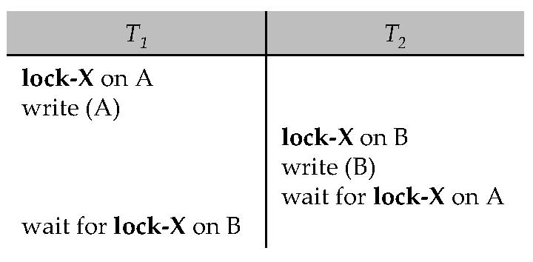
Deadlock
Consider the following two transactions:
T₁: write (A) T₂: write(B)
write (B) write(A)
Schedule with deadlock
System is deadlocked:
if there is a set of transactions such that every transaction in the set is waiting for another transaction in the set.

Slide 18
Deadlock Recovery
When deadlock is detected:
Some transaction will have to rolled back (made a victim) to break deadlock.
Select that transaction as victim that will incur minimum cost.
Rollback -- determine how far to roll back transaction
Total rollback: Abort the transaction and then restart it.
More effective to roll back transaction only as far as necessary to break deadlock.
Starvation happens if same transaction is always chosen as victim.
Include the number of rollbacks in the cost factor to avoid starvation

Slide 19
Activities and assessments
Please find activities and assessments on concurrency control under the activity section

Slide 20
Summary
Concurrency Control
Pessimistic: Prevent conflict from happening
Optimistic: Detect the conflict that happens and resolve the problem
Two-Phase Locking (2PL)
Two types of locks:
Shared (S) locks for read-only access
Exclusive (X) locks for write + read access
Strict Two-Phase Locking (S2PL)
Exclusive locks are held until transaction commit
Strict Strong Two-Phase Locking (SS2PL)
All locks held until transaction commit/abort
Deadlocks
Recovery: Rollback a transaction to break a deadlock.

